Slide 1
SMART STUDY PLANNER
CAPSTONE PROJECT
Presented By: Dhanush Hebbar College Name: Shree Devi Institute of Technology
Department: MCA

Slide 2
OUTLINE
Problem Statement
System Development Approach
Algorithm & Deployment
Result
Conclusion
Future Scope
References

Slide 3
Problem Statement
Students often struggle to manage study tasks, deadlines, and focused study sessions using multiple tools.
Current problems:
Tools are often too complex for daily academic use.
Many apps lack an integrated calendar + analytic view for study planning.
No easy way to add subject-specific tasks, export/import backups, or use a Pomodoro timer in the same workspace.
Goal: Build a single lightweight student-focused planner that combines tasks, calendar, analytics, timer, and easy import/export.

Slide 4
System Approach
Frontend: HTML5, CSS3 (responsive + dark theme), Vanilla JavaScript (ES6+)
Storage: Browser LocalStorage for fast local persistence (JSON), Import/Export via JSON files
Design: Mobile-first responsive layout
clear cards
subtle transitions
accessible controls
Key UX choices: Custom subjects
quick-add from calendar modal
“Show Filtered” for focused lists

Slide 5
Algorithm & Deployment
Task object model (stored as JSON): { id, title, subject, notes, due, time, priority, done, created }
Add / Edit / Delete: Create tasks (main form or calendar modal).
Edit by populating form and saving. Delete removes item and re-renders.
Calendar:
Renders current month grid, counts tasks per date, click date → modal (view tasks + quick-add for that date).
Selected date visually highlights.
Filters: Dynamic subject list (from created subjects) + priority filter.
“Show Filtered Tasks” toggles a filtered interactive block (checkbox + delete).
Pomodoro timer: 25:00 default, Start/Pause/Reset, cycle count stored.
Visual running indicator and local message displayed near timer.
Analytics: Compute pending tasks grouped by subject → draw pie slices + legend, show percentages.
Persistence & Backup: All tasks saved to LocalStorage; Export downloads JSON; Import reads JSON, merges tasks.
Deployment: Hosted on Vercel — static site (HTML/CSS/JS) — push code to GitHub, connect to Vercel, auto-deploy.

Slide 6
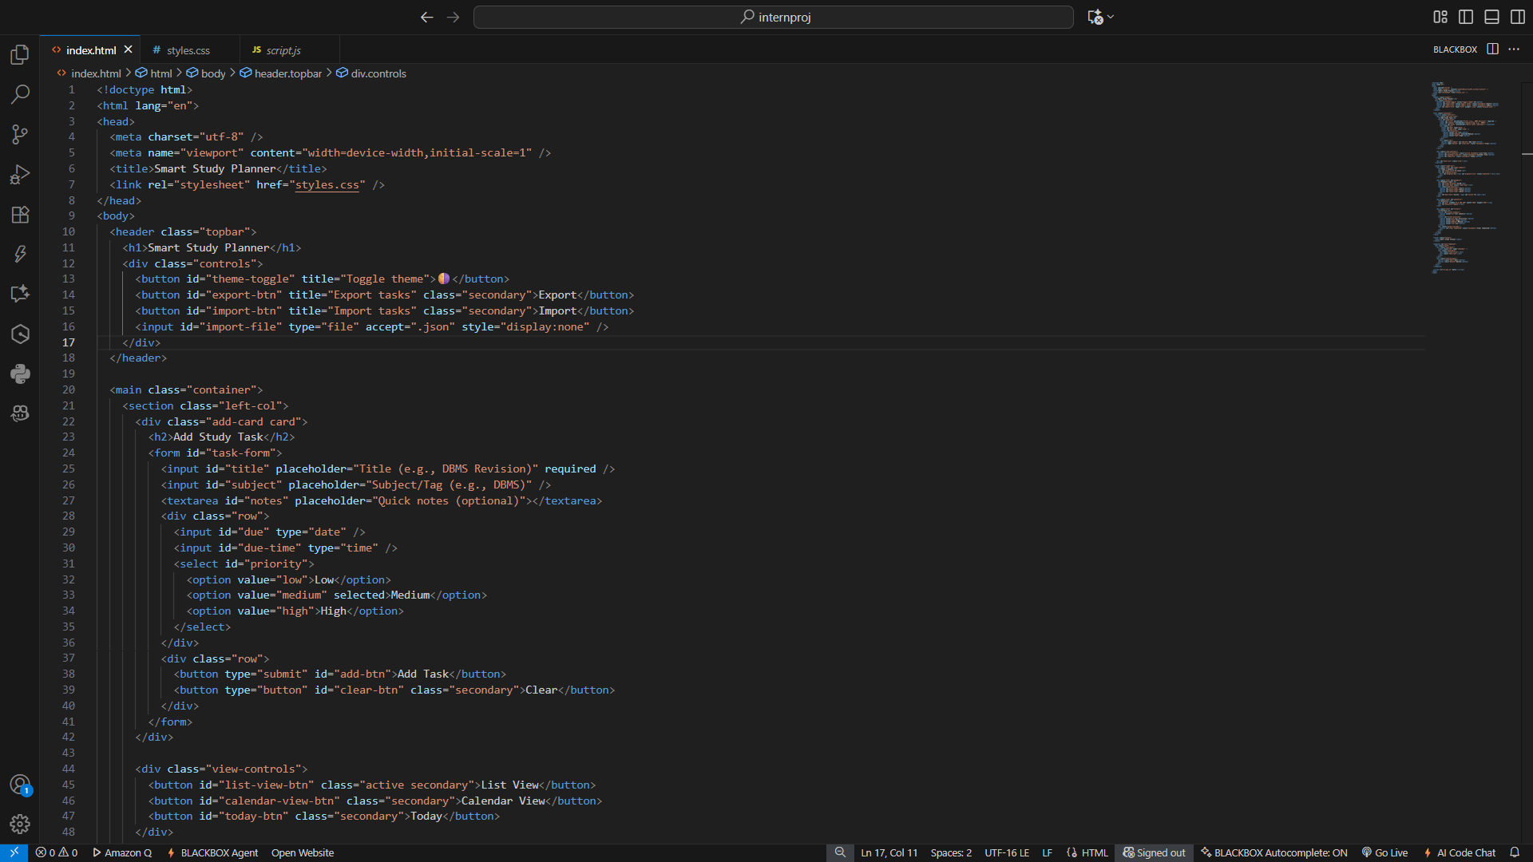
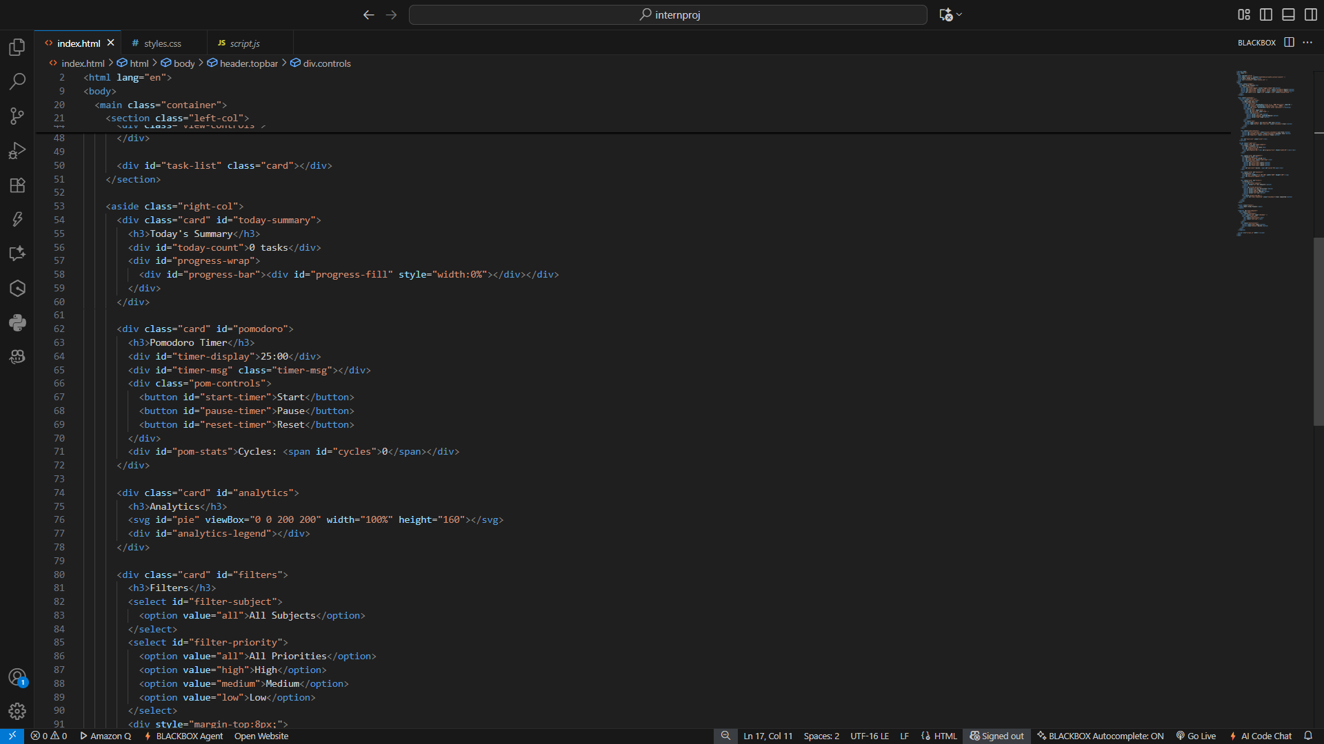
Result
CODE SNIPPETS

Slide 7
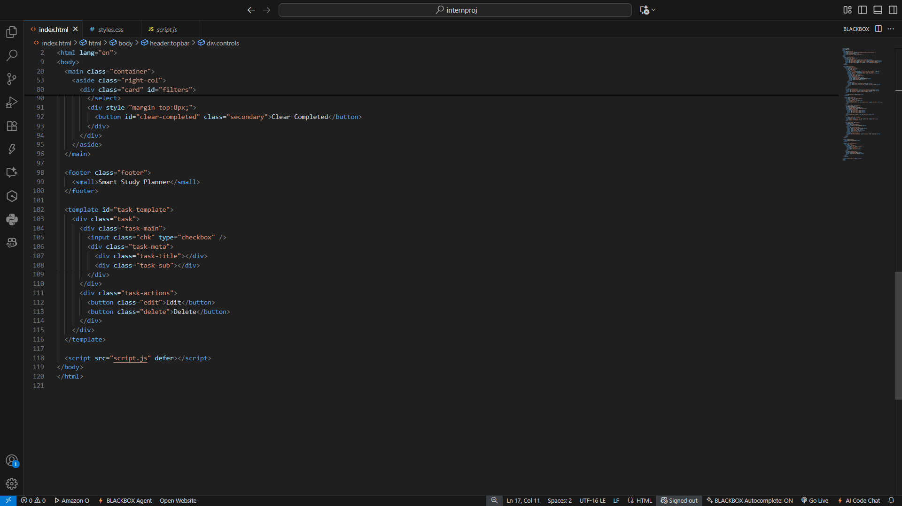
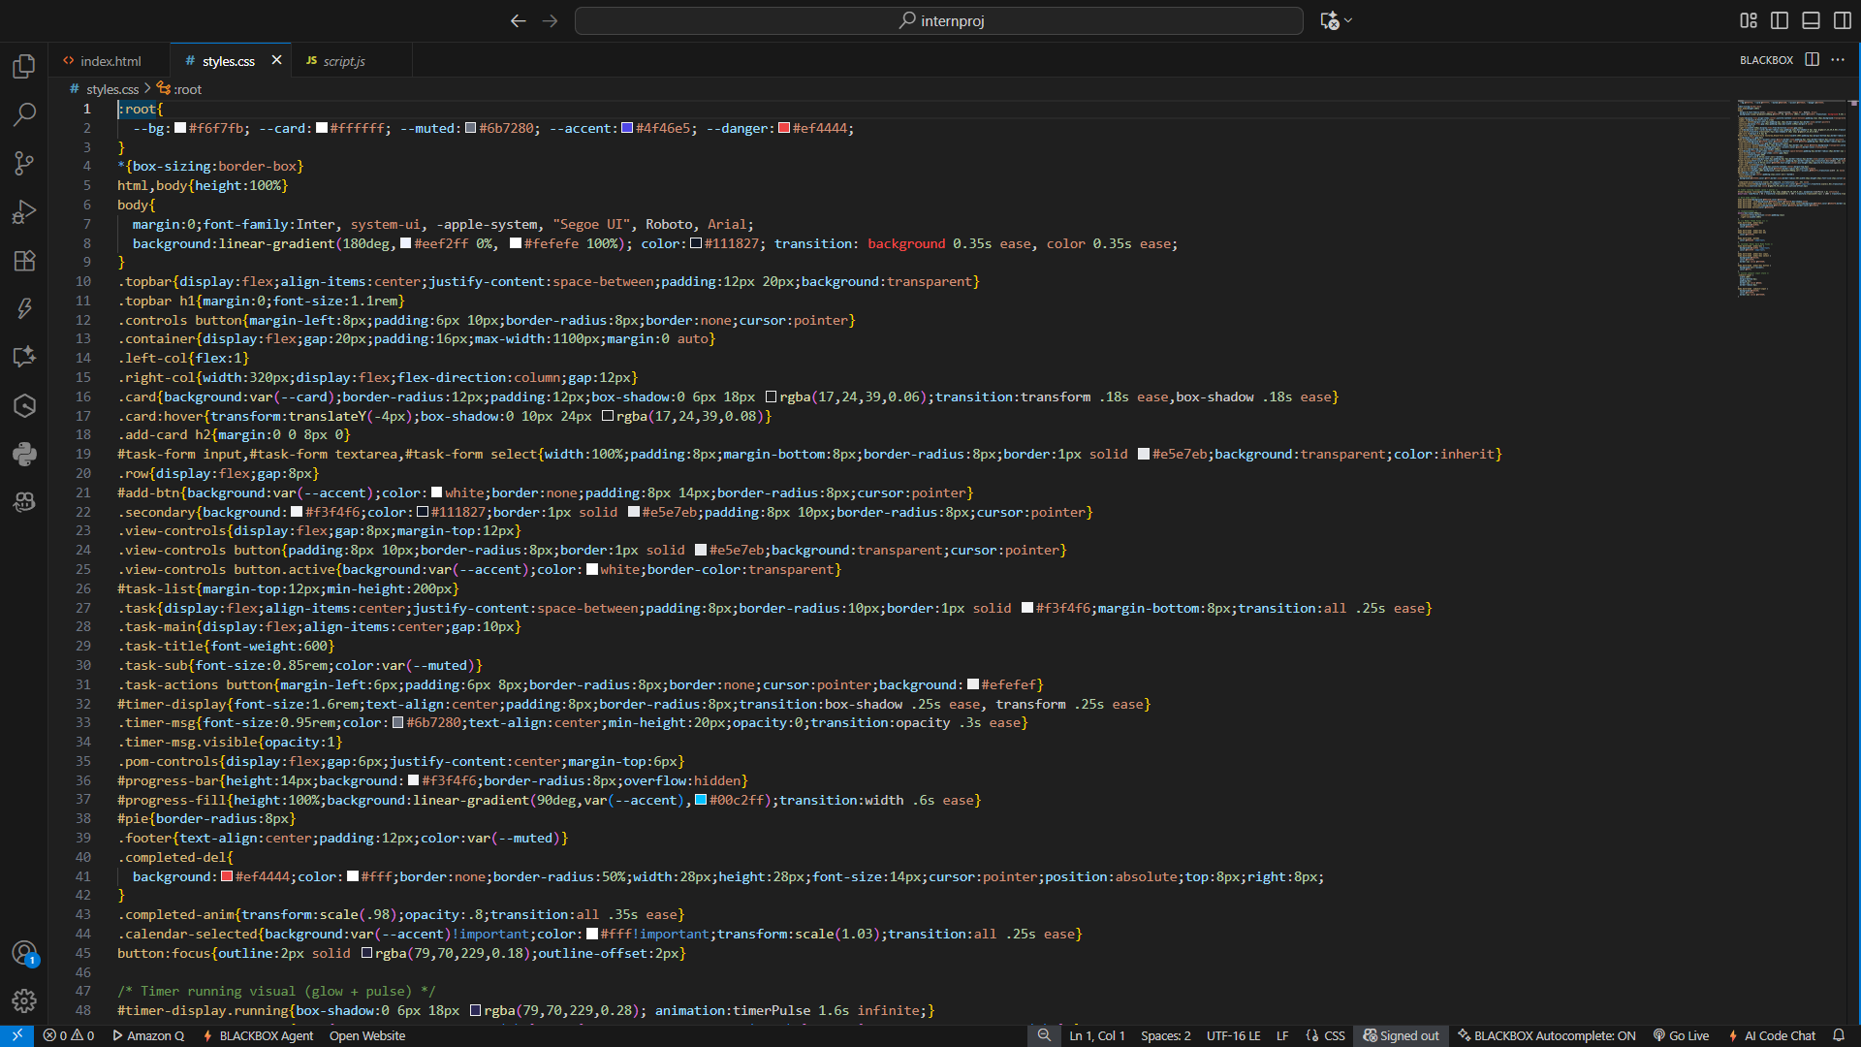
Result

Slide 8
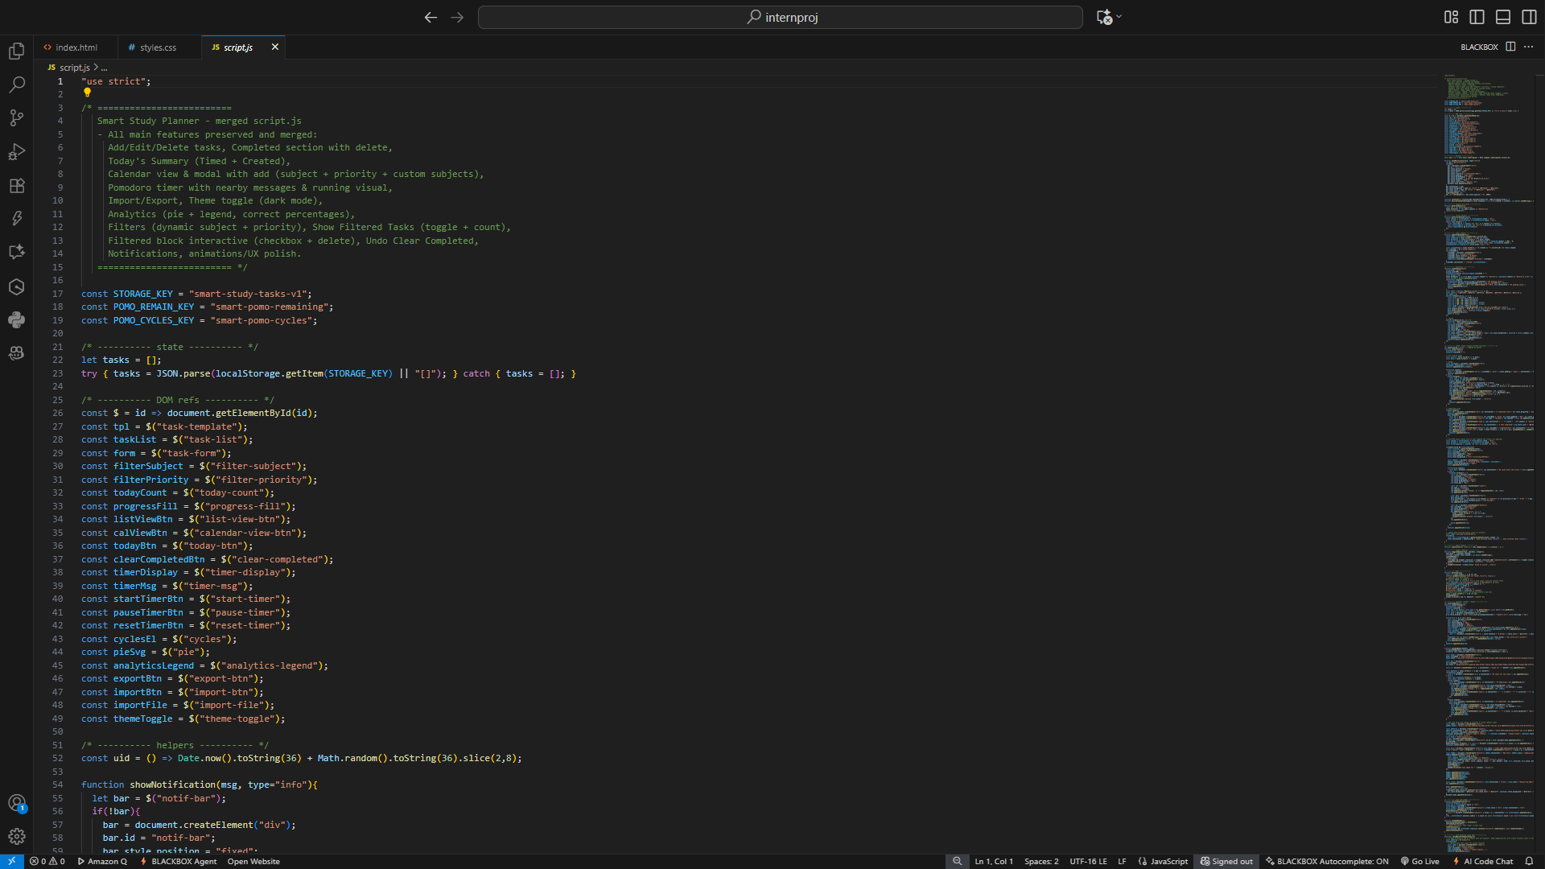
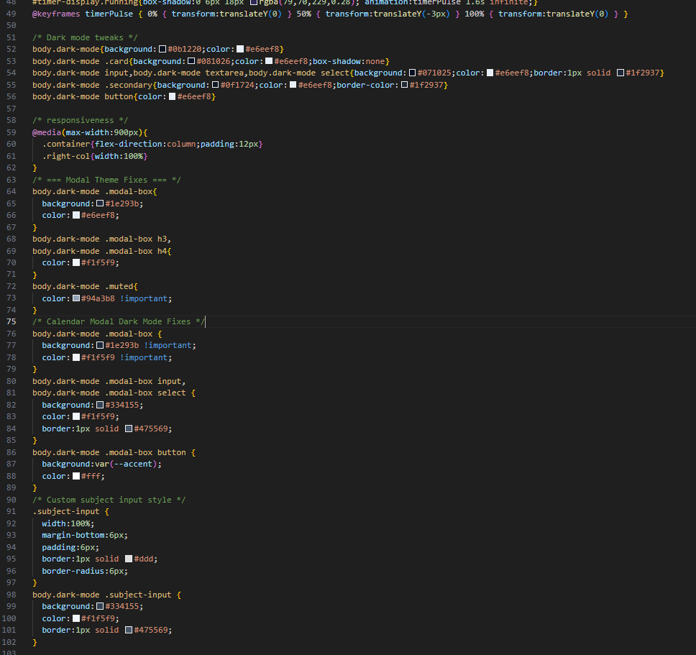
Result

Slide 9
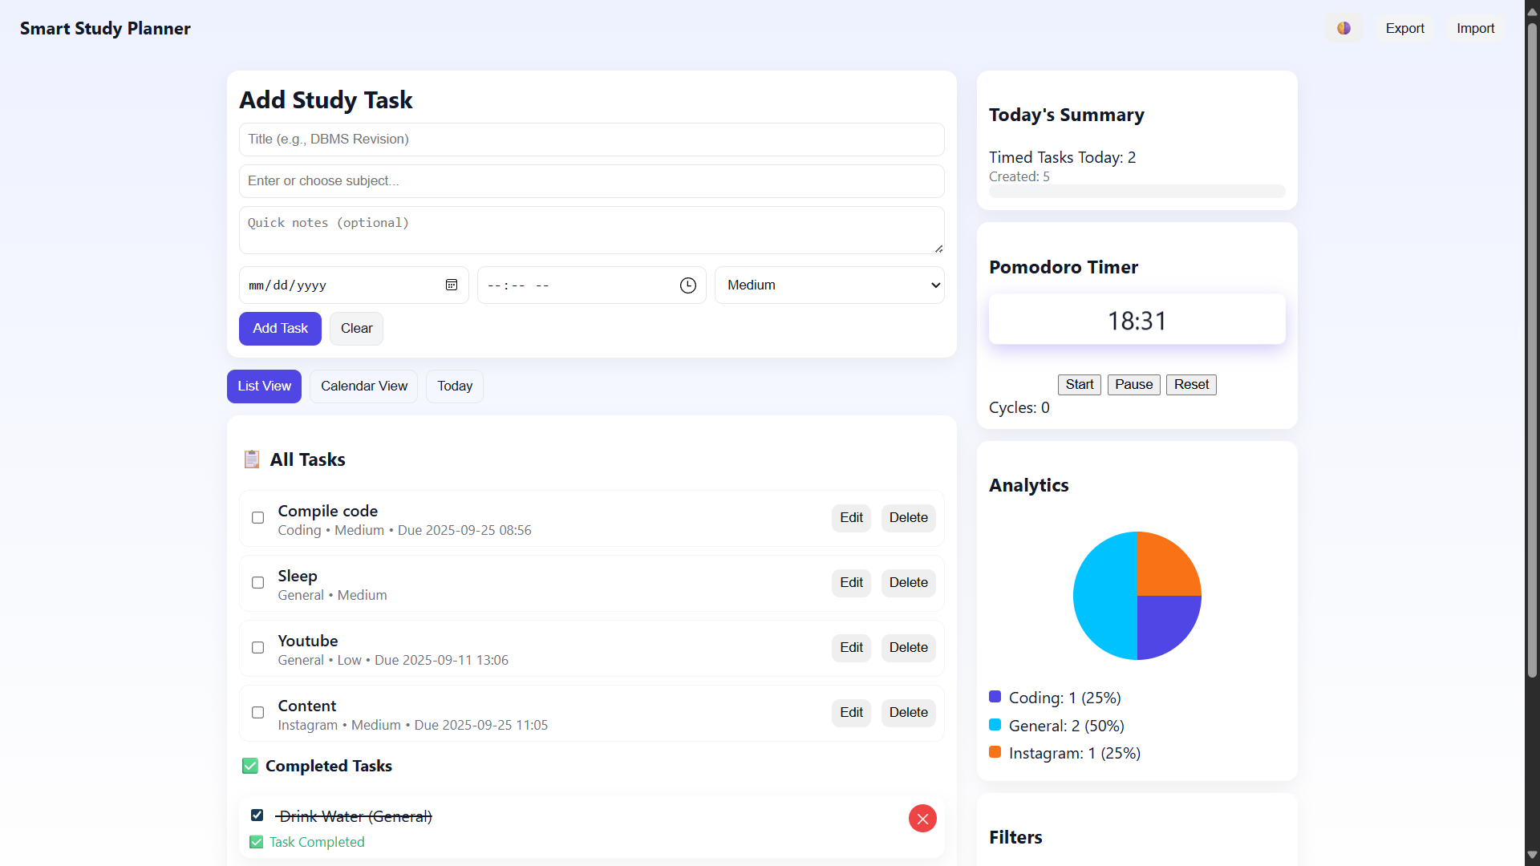
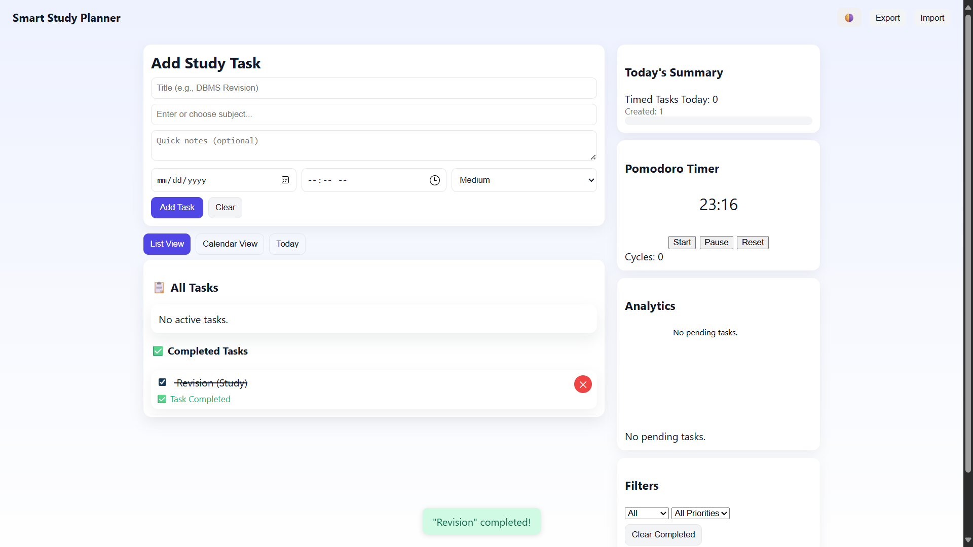
Result
Output

Slide 10
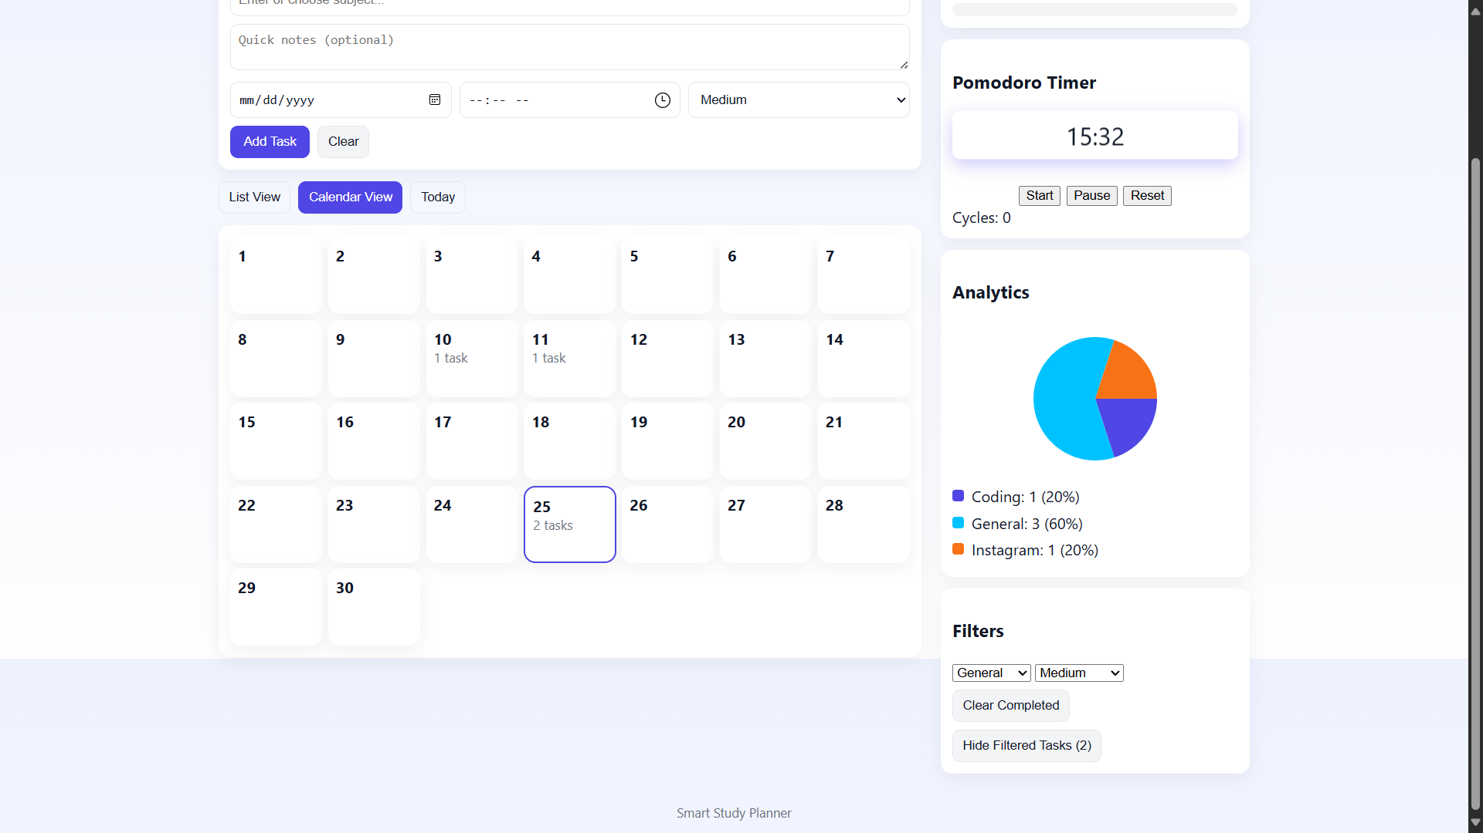
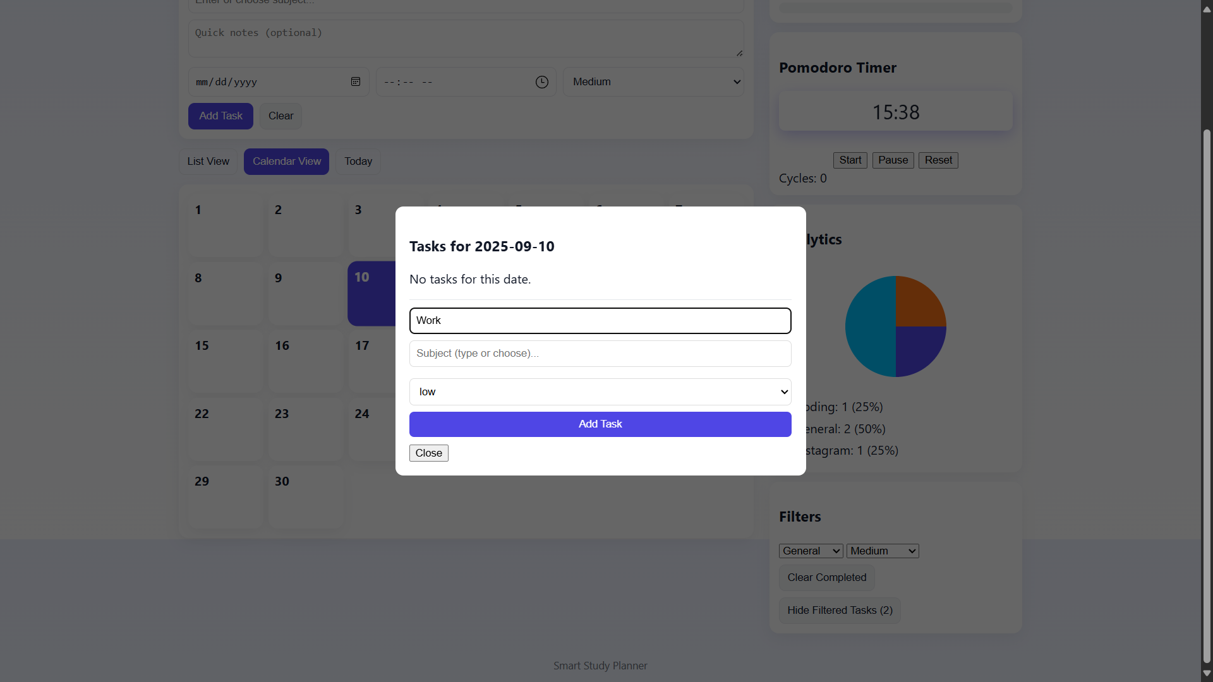

Slide 11
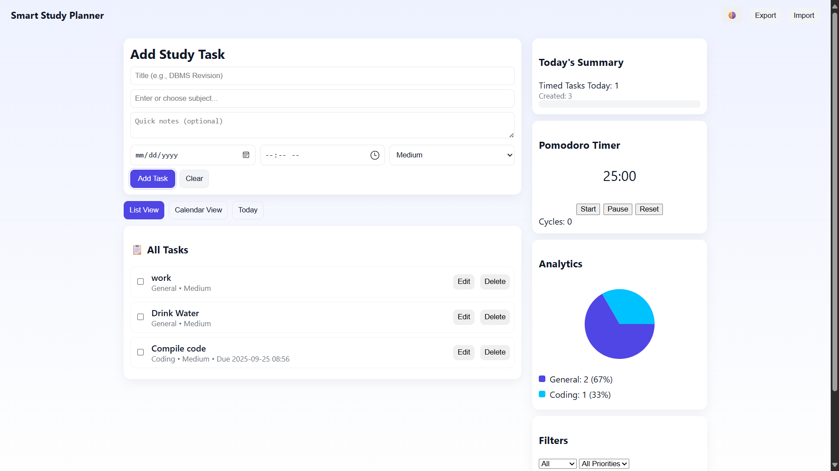
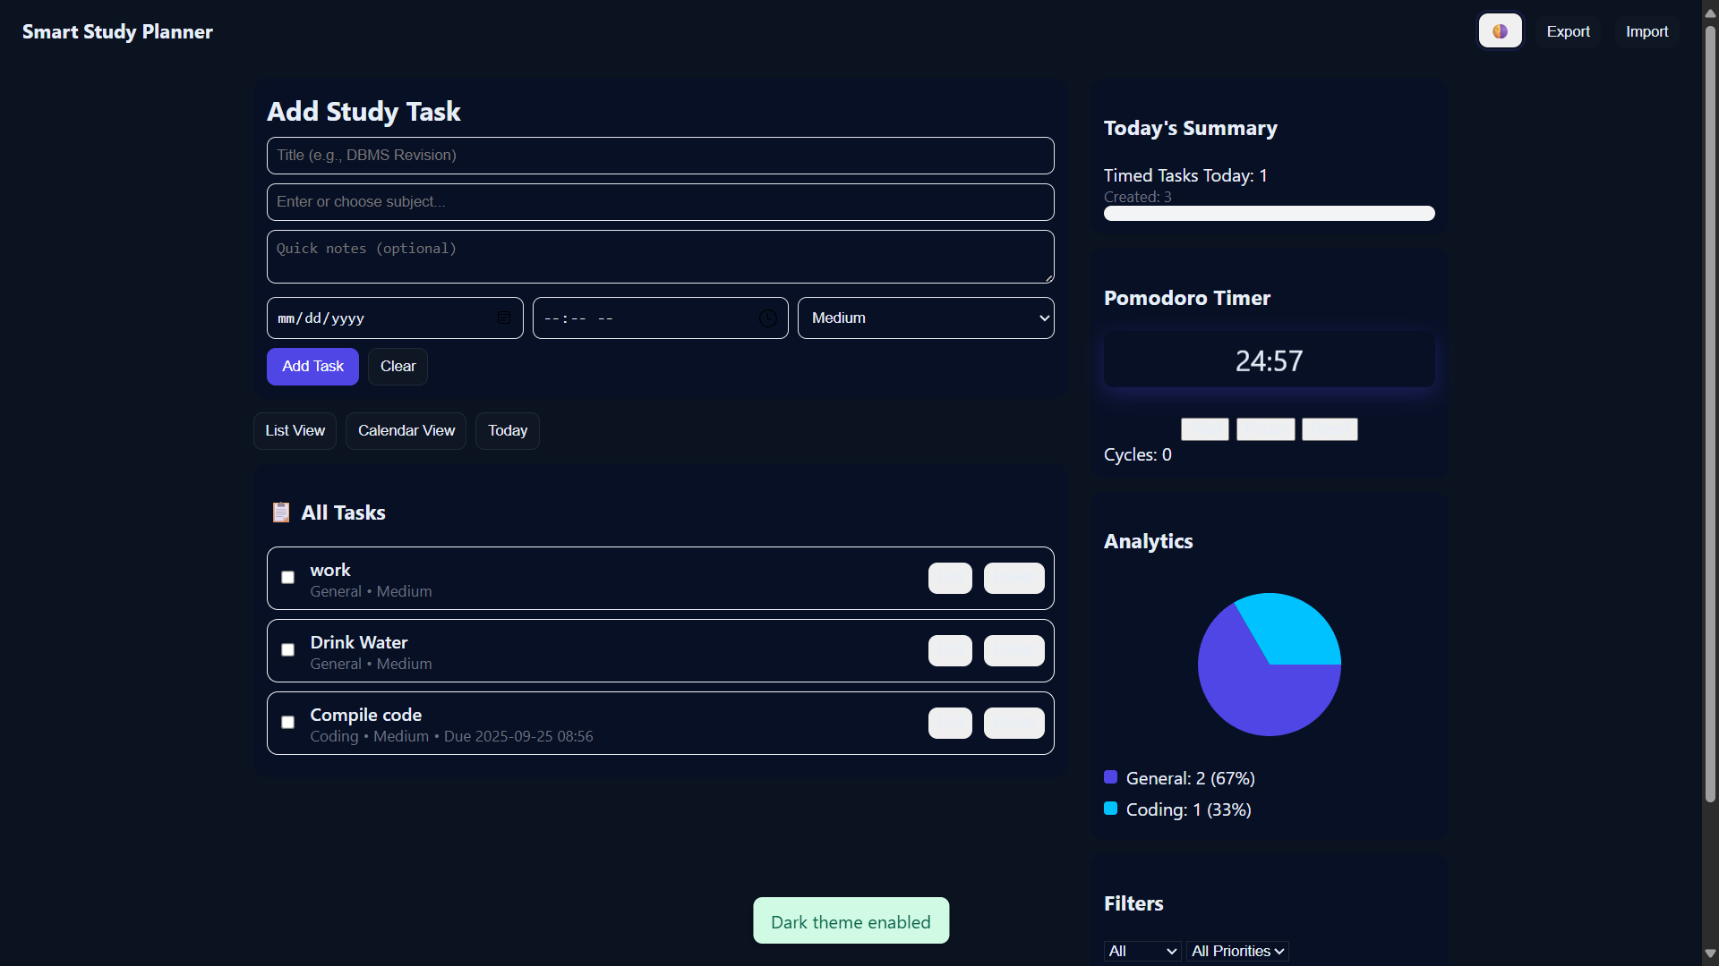

Slide 12
GITHUB AND DEPLOYMNET LINK
Github Link : https://github.com/Dhanushhbbr/study-planner
Deployment link: https://study-planner-ochre.vercel.app/

Slide 13
Conclusion
Developed a comprehensive productivity solution tailored for students, integrating all essential study management features in one platform.
Successfully combined task management, calendar planning, Pomodoro productivity techniques, and performance analytics into a single lightweight web application.
Ensured ease of use, responsive design, and theme adaptability to provide a seamless experience across devices.
The project demonstrates the practical application of web technologies (HTML, CSS, JavaScript) to solve real-world academic challenges.
By eliminating the need for multiple separate tools, the solution improves time management, focus, and overall study efficiency.

Slide 14
Future scope
Cloud Sync & Multi-user: Add backend (Firebase/Supabase) for cross-device sync and user accounts.
Notifications: Browser or mobile push reminders before due time.
Recurring Tasks: Automatic repeat (daily/weekly).
Customizable Pomodoro: Configurable work/break durations and auto-break start.
PWA / Offline-first: Installable web app with background sync.
AI features: Smart scheduling recommendations based on past behavior.

Slide 15
References
AICTE Internship Portal & Edunet Foundation / IBM SkillsBuild materials
MDN Web Docs — JavaScript, HTML, CSS
Vercel documentation (deployment)
Open-source UI/UX resources & color accessibility guidelines

Slide 16
THANK YOU

